Slide 1
Build Management
Clean environment that works...
Henrik Bærbak Christensen

Slide 2
Motivation
Sun provides Java SDK free of charge
  provides standard command line tools: javac, java, ...
These are sufficient only for very small systems
  javac only compile one directory at a time
  javac recompiles everything everytime
Large systems require many tasks
  manage resources (graphics, sound, config files)
  deployment (making jars, copying files)
  management (javadoc, coverage, version control)
Henrik Bærbak Christensen

Slide 3
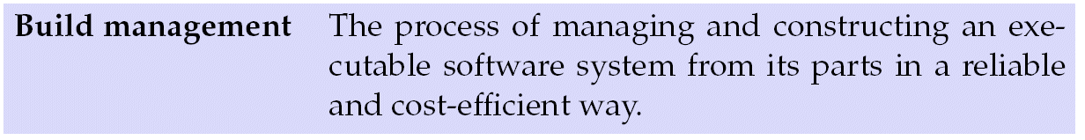
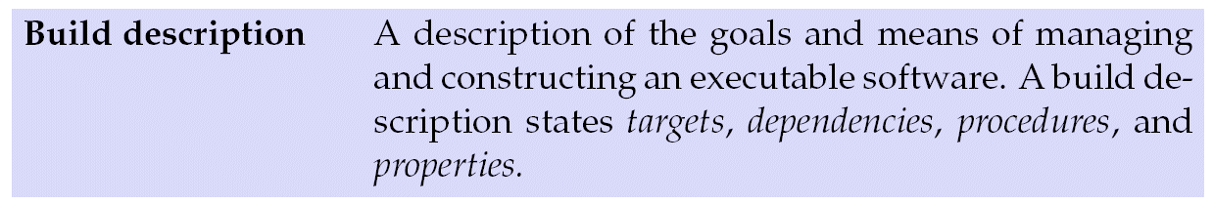
Build-Management
This problem is denoted:
Computer Scientists’ standard solution: a tool...
The tool read a build-description
Example: Make (Feldmann, 1979)
Henrik Bærbak Christensen

Slide 4
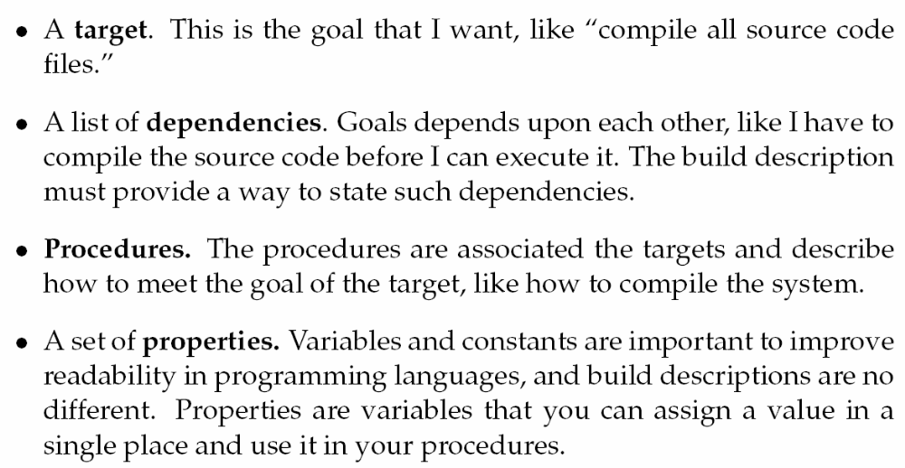
Script Parts
Henrik Bærbak Christensen

Slide 5
Exercise
I want to run my Java system that is made of 500 sources files
  target?
  dependencies?
  procedure?
  properties?
Henrik Bærbak Christensen

Slide 6
Apache Ant
Ant is a young build-management tool geared towards Java
  ☺ has some strong build-in behaviour
    javac on source trees and does smart recompile
  ☺ independent of large IDEs
    easy for TA to unzip your submission and test it
  ☹ on the XML buzzword wave so it is verbose
Henrik Bærbak Christensen

Slide 7
Pay Station using Ant

Slide 8
The TDD again
In my mind, TDD’s principles can be applied more widely than just developing code.
Basically I want a refactoring process
  from a windows .BAT development environment
  to an Ant based development environment
  ... but the external behaviour is the same:
    compile it, test it
Henrik Bærbak Christensen

Slide 9

Test List
I start out (of course) with the test list
Henrik Bærbak Christensen

Slide 10
Java Packages
... in a minute or two...

Slide 11
Abstraction
Abstraction is the most important principle in computer science
  lower cognitive load on our poor mind by
  hide large amounts of details behind meaningful named entities
Examples:
  method
    (name a large and complex set of statements)
  class
    (name a large and complex set of methods)
Henrik Bærbak Christensen

Slide 12
Package
The Java package is the next level above classes.
Definition: A package is a collection of related classes and interfaces providing access protection and namespace management.
Henrik Bærbak Christensen

Slide 13
Declaration
A class declares that it belongs to a package by a statement:
package myPackage;
public class mySuperDuperClass {
…
}
Pretty weird! Compare C#
  namespace myPackage { class ... }
Henrik Bærbak Christensen

Slide 14
Access
To use a class in a package you must either
  qualify its name completely (package names are part of the class name)
    java.util.List l = new java.util.ArrayList();
  or once and for all import the class
    import java.util.List; import java.util.ArrayList;
  or get all the classes
    import java.util.*;
Henrik Bærbak Christensen

Slide 15
Physical Structure
Java is peculiar in that it insists on a one-to-one match between package structure and physical storage structure of the binary .class files:
  java.util.List
  must be stored in a directory structure
  (something)/java/util/List.class
  (something)/java/util/List.java
I like the correspondence as it helps me locate the source files!
Henrik Bærbak Christensen

Slide 16
Classpath
You must tell where the compiler and JVM must start searching for the files:
  (something)/java/util/List.class
The CLASSPATH tells where ‘something’ is.
  javac –classpath src;lib\myutil.jar myclass.java
  means: search in folder ‘src’ and in the named jar file.
jar files are simply zip archives that obey the folder hierarchical structure.
Henrik Bærbak Christensen

Slide 17
Iteration 1
Packages

Slide 18
Pay Station
[iteration-1 in chapter/build-management in the FSE source code zip]
Henrik Bærbak Christensen

Slide 19
Iteration 2
Make a compile target

Slide 20
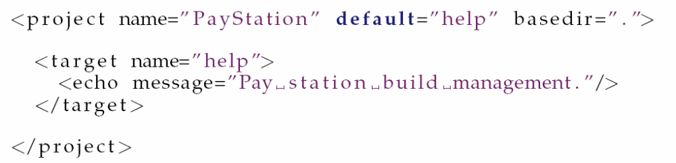
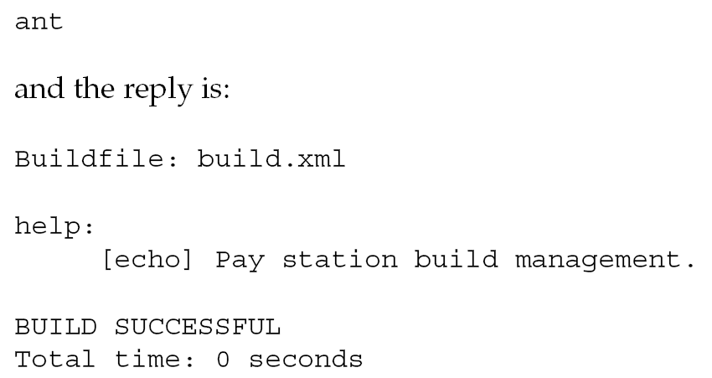
Hitting Ant
Take small steps!
Target
Procedure
Henrik Bærbak Christensen

Slide 21
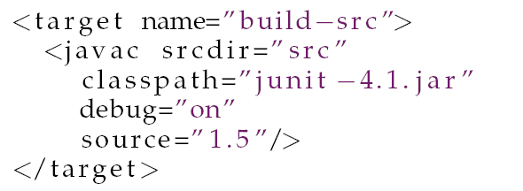
javac task
javac does
  recursive descent in full source code tree
  smart compilation
Henrik Bærbak Christensen

Slide 22
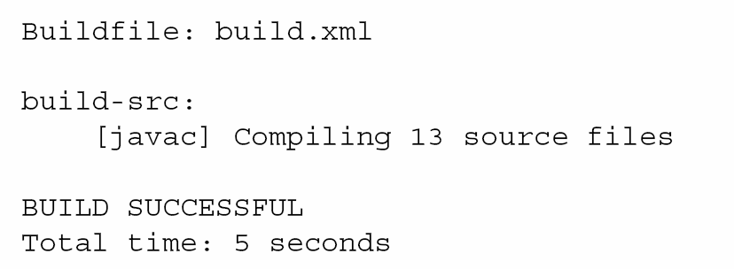
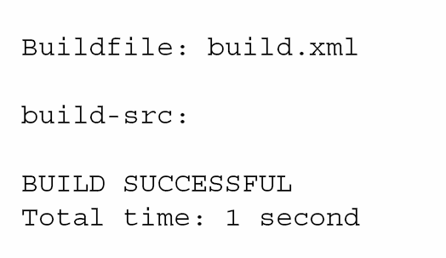
Smart Compilation
Henrik Bærbak Christensen

Slide 23
Iteration 3
Running the tests

Slide 24
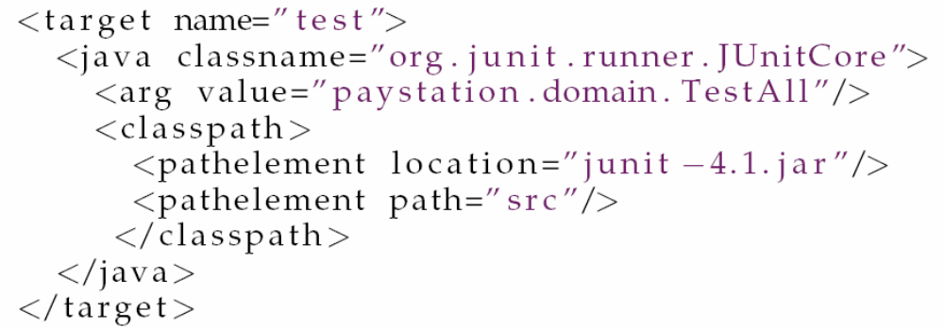
java task
Henrik Bærbak Christensen

Slide 25
Iteration 4
Split Build Tree

Slide 26
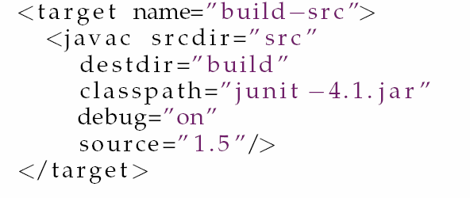
Avoid pollution
I like to keep things separate!
  source code trees should not contain .class files
Henrik Bærbak Christensen

Slide 27
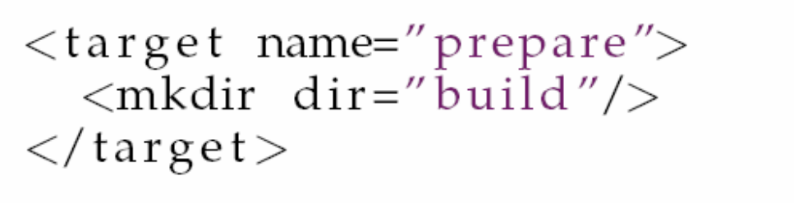
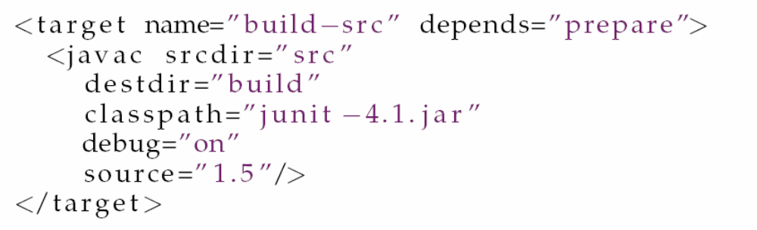
Dependencies
It however fails because no ‘build’ directory exists. Let us resolve that using a prepare target.
Henrik Bærbak Christensen

Slide 28
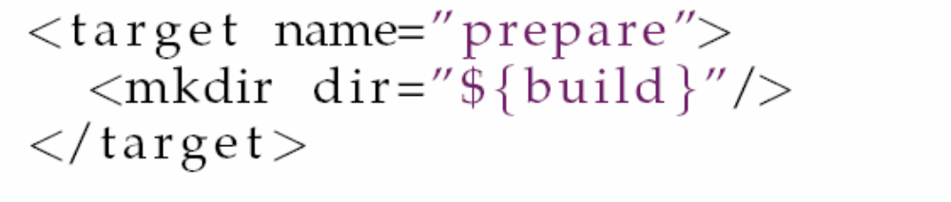
Refactoring
Refactor to clean up!
  ‘build’ as string literal all over the place
(I think build-tools compete to introduce really weird syntax!!!)
Henrik Bærbak Christensen

Slide 29
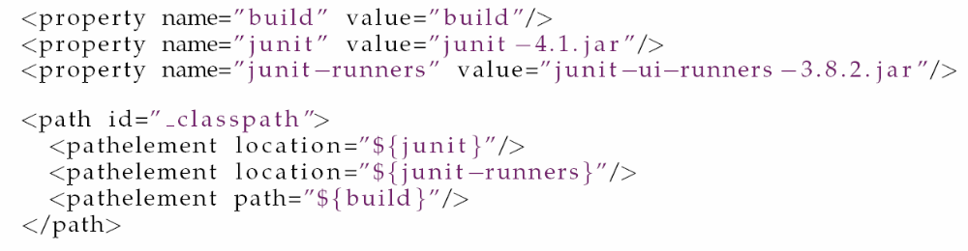
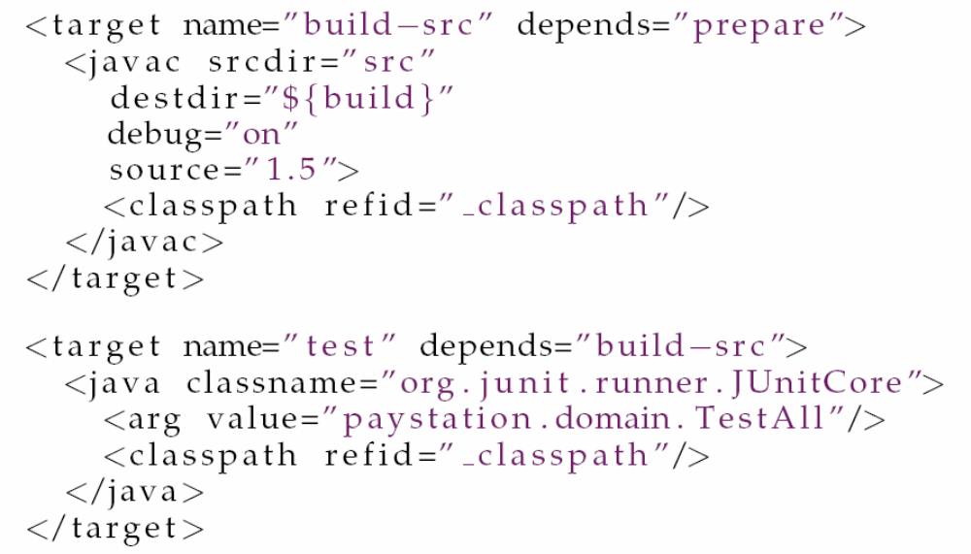
Cleaning up classpath
Henrik Bærbak Christensen

Slide 30
Iteration 6
Split production and test tree

Slide 31
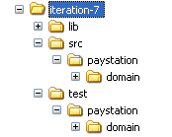
Splitting the trees
Advantages
  Make javadoc without refering to unit test
  Make jar of production code without unit test
Henrik Bærbak Christensen

Slide 32
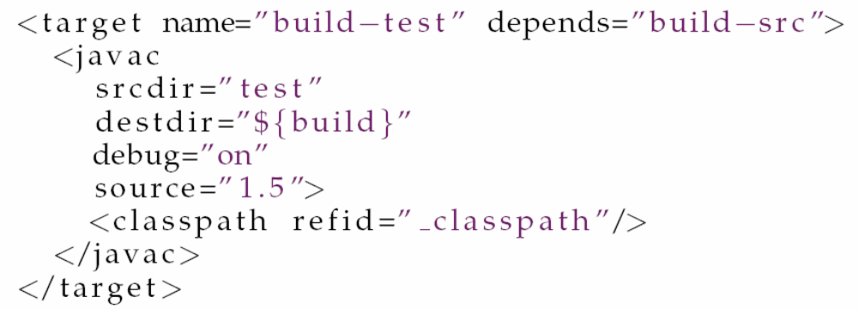
Require New Task
Have to build the test tree as well
Henrik Bærbak Christensen

Slide 33
Summary

Slide 34
Summary
Build-management automates many ‘house-hold’ tasks
Build-management = tool + build script
Build scripts are documentation!
  tell me how to run servers and clients even when names and topologies have changed
    as long as we agree on the task names, like “run-server”
Henrik Bærbak Christensen

